Slide 1

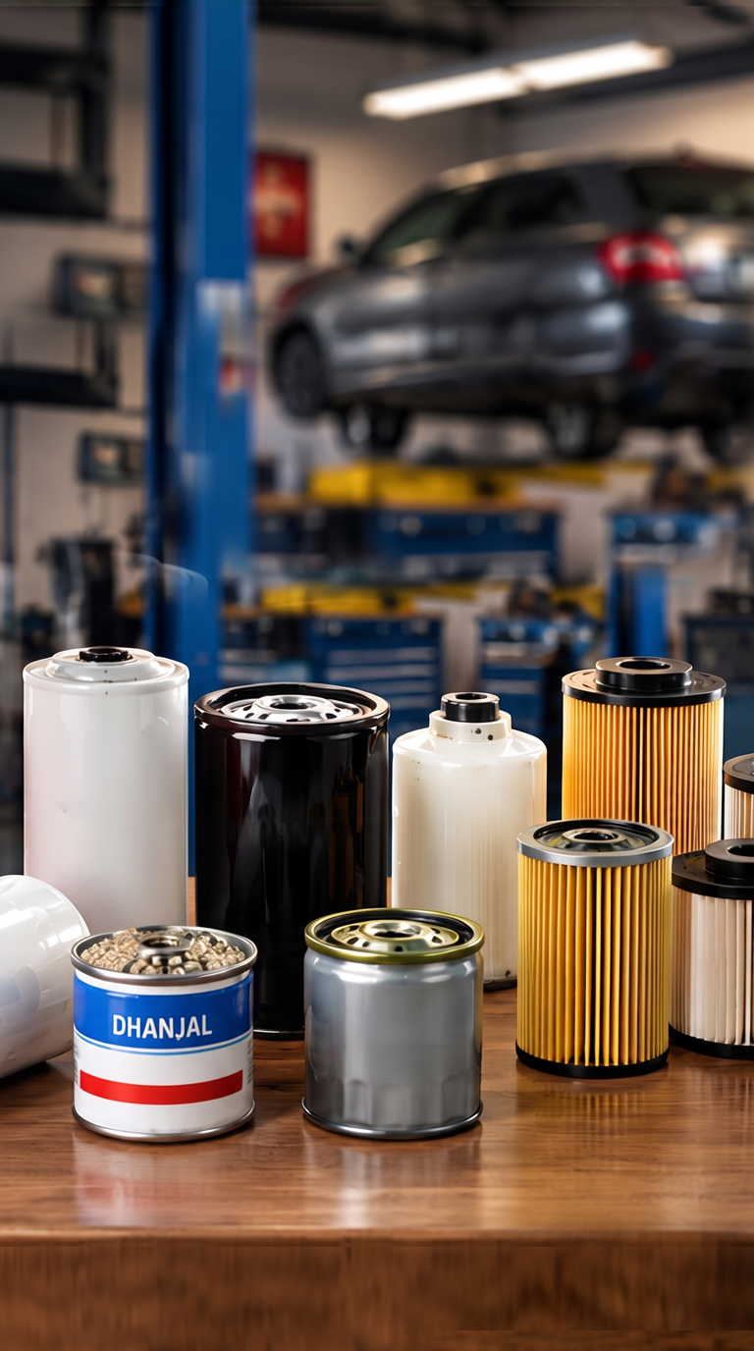
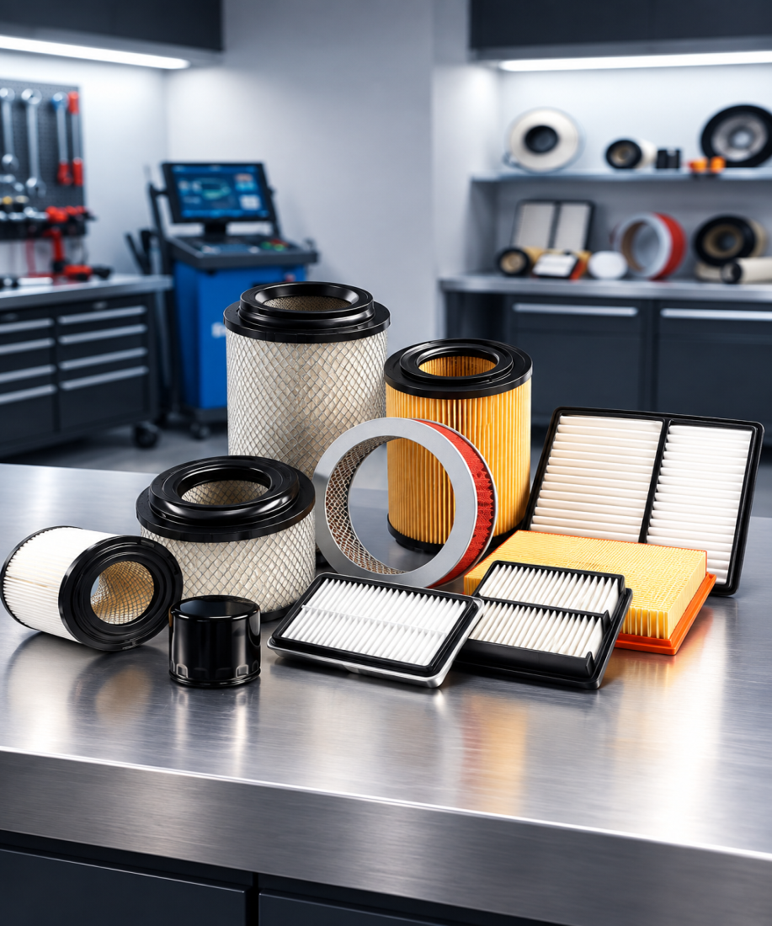
TIER-1 AUTOMOTIVE & INDUSTRIAL FILTRATION OEM
DHANJAL IMPEX (P) LTD.
Manufacturer Of All Types Of Automotive Filters & Sheet Metal Components
IATF 16949:2016
ISO 9001:2015
ISO 14001:2015
ISO 45001:2018
ESTD. 1990
Pioneering Filtration Excellence Since 1990

Slide 2

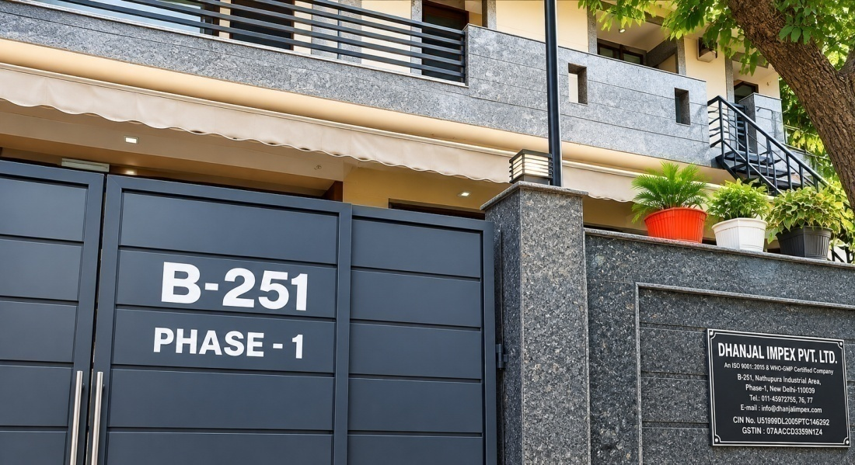
who we are
Powering Progress with Precision Filtration Solutions
30+ Years
1,500+ SKUs
Dhanjal Impex (P) Ltd. was founded in 1990 by Mr. Jagtar Singh Dhanjal, our visionary Managing Director, Mr. Iqbal Singh Dhanjal. What began as a specialized facility with advanced filter-making machines has steadily grown into a premier enterprise equipped with state-of-the-art testing laboratories and a dedicated team of engineering professionals.
Our major buyers are exclusively Original Equipment Manufacturers (OEMs). To overcome the challenge of procuring premium impregnated filter paper, we invested in our own in-house resin paper impregnation plant, ensuring uncompromised quality from raw media to finished assembly.
Our Core Corporate Mission
Deliver benchmark filtration efficiency and zero-defect zero-ppm quality to Tier- 1 OEMs.
Provide continuous career growth, high safety, and skill enhancement for our workforce.
Serve as a high-integrity, profitable, and technologically dependable manufacturing partner.
Maintain green, sustainable, and eco-friendly manufacturing with zero-discharge processes.
Manufacturing Legacy (Since 1990)
Extensive Filter Portfolio
50+ OEMs
10M+ Units
Domestic & Global Partners
Annual Manufacturing Capacity
DHANJAL IMPEX (P) LTD. | IATF 16949 & ISO 9001 CERTIFIED OEM PARTNER
www.dhanjalimpex.com | info@dhanjalimpex.com

Slide 3
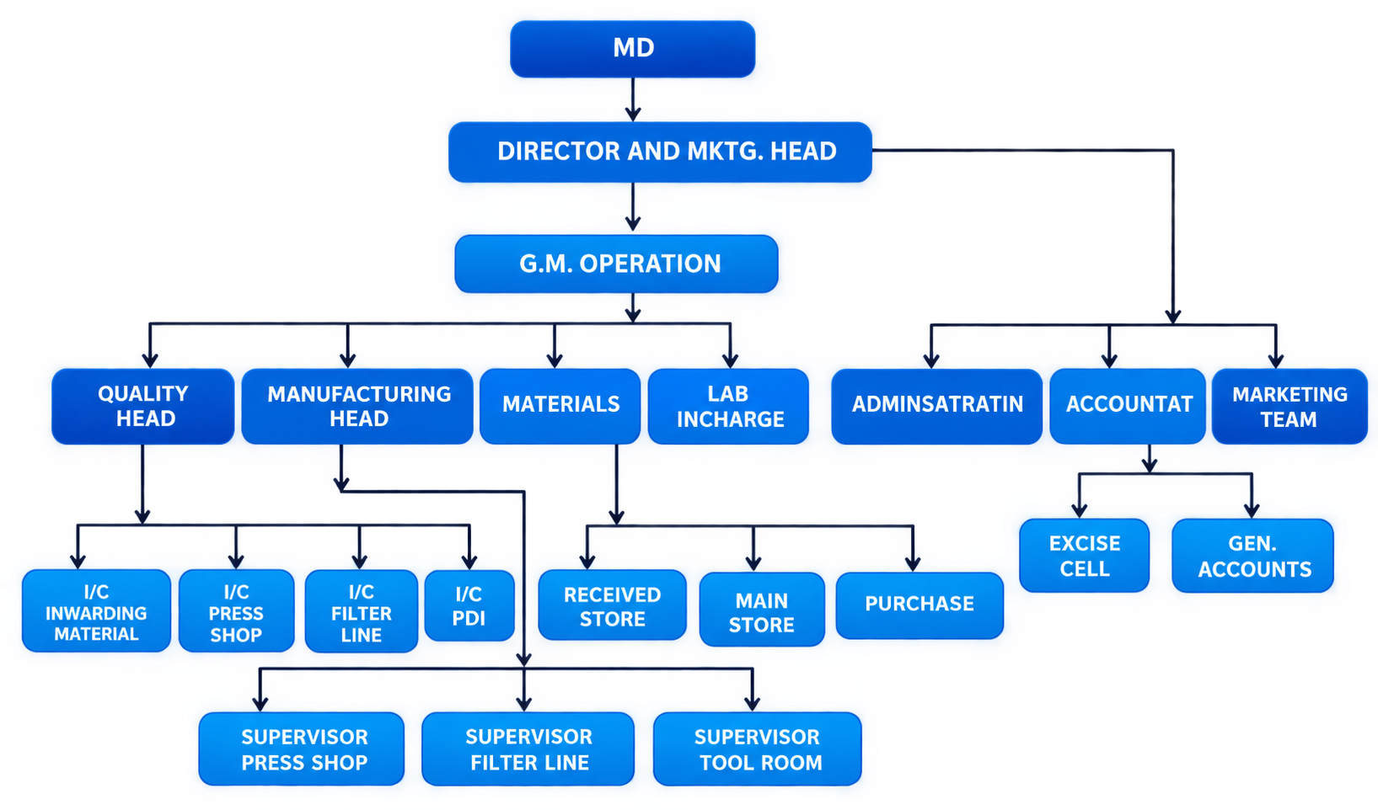
Organizational Structure
DHANJAL IMPEX (P) LTD. | IATF 16949 & ISO 9001 CERTIFIED OEM PARTNER
www.dhanjalimpex.com | info@dhanjalimpex.com

Slide 4
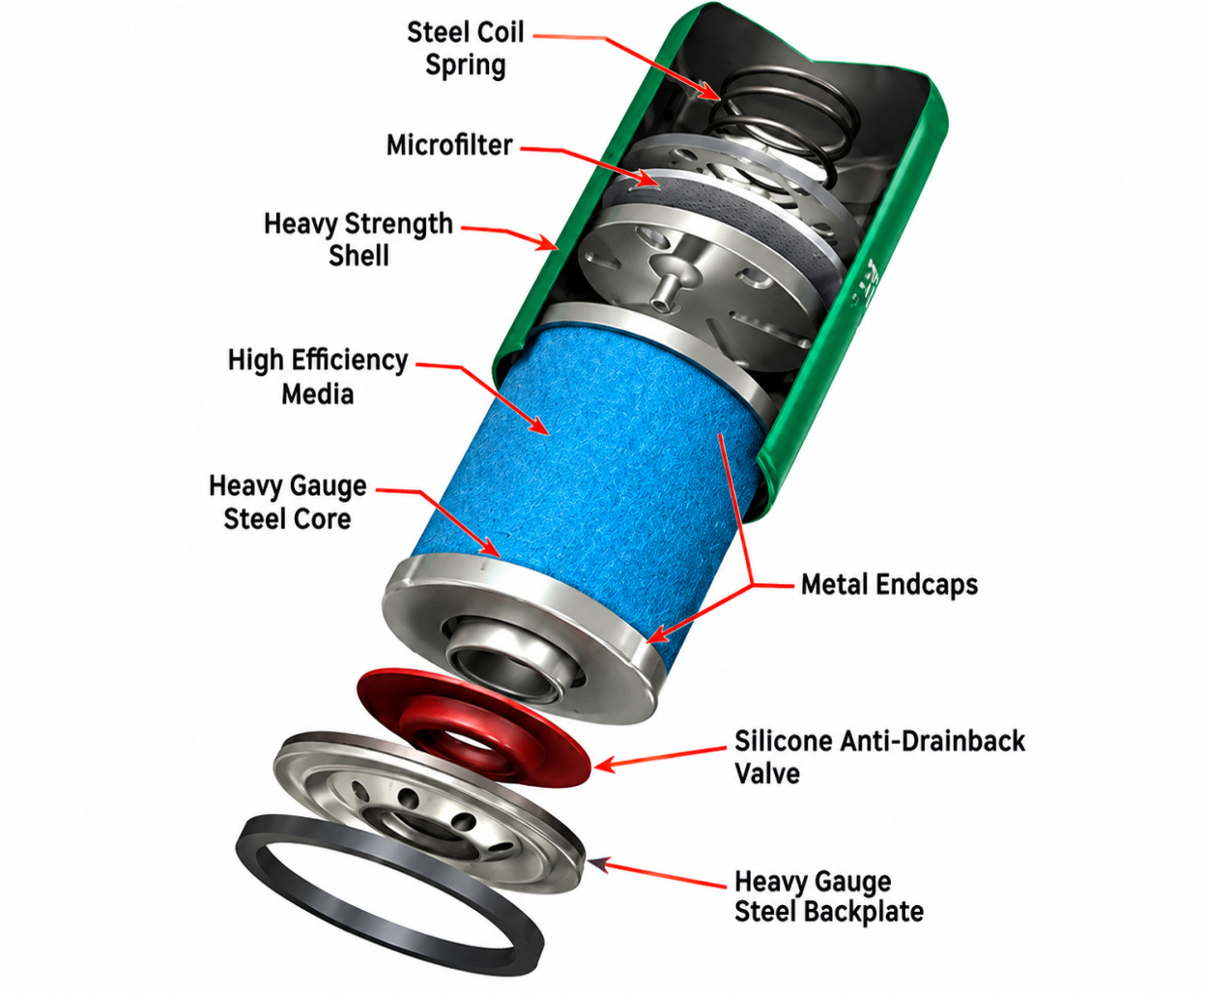
Products Suite
Oil Filters (Spin-On)
Full-Flow Lubrication with Zero Bypass Contamination
Engine wear is mainly caused by abrasive particles thicker than the oil film between bearing surfaces. Modern engine clearances are as low as 2 to 5 microns. By trapping these particles within its media pores, the Dhanjal oil filter provides effective protection against premature crankshaft and journal bearing failure.
Manufactured with deep-drawn cold rolled steel shells, silicone anti-drainback valves, and phenolic resin-treated cellulose/synthetic microglass pleats.
Deep-Drawn Canister: Heavy gauge cold-rolled steel tested to withstand over 20 bar hydrostatic burst pressure.
Silicone Anti-Drainback Valve: Prevents dry start-ups by retaining oil in the canister when the engine is stopped.
Calibrated Bypass Relief Valve: Ensures uninterrupted engine oil flow during cold starts or media clogging.
DHANJAL IMPEX (P) LTD. | IATF 16949 & ISO 9001 CERTIFIED OEM PARTNER

Slide 5
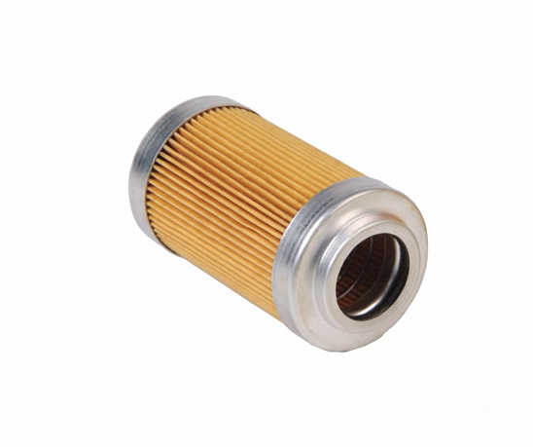
Products Suite
Fuel Filters & Water Separators
Hydrophobic Separation with 99.5% Free Water Removal
A pristine fuel supply is critical for internal combustion performance and injector durability. Modern common rail injection systems operate at ultra-high pressures exceeding 2,000 bar where microscopic water droplets cause hydraulic erosion and injector scoring.
Dhanjal fuel filter assemblies integrate multi-layered hydrophobic synthetic media that coalesces emulsified water while filtering 2–5 micron abrasive silica particles.
Multi-Stage Coalescing Media: Seamlessly separates emulsified water droplets into a high-visibility collection bowl.
2–5 Micron Precision Capture: Protects injector pump plunger barrels and delivery valves from catastrophic abrasion.
Corrosion-Resistant Housing: Internal electro-coat treatment and synthetic drain valves preventing fuel acidification corrosion.
DHANJAL IMPEX (P) LTD. | IATF 16949 & ISO 9001 CERTIFIED OEM PARTNER

Slide 6
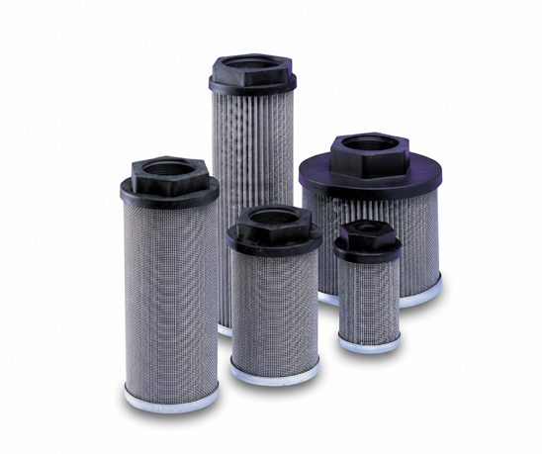
Products Suite
Industrial Pipeline Strainers
Rugged Construction with Minimal Pressure Drop
A pipeline strainer mechanically removes solids from flowing liquids or gases using perforated sheets or wire mesh straining elements. The particle removal range spans 1/2" down to 100 mesh (0.0055").
Dhanjal strainers protect costly downstream equipment such as hydraulic pumps, control valves, flow meters, steam traps, and spray nozzles from pipeline joint compound, pipe scale, and debris.
Minimal Pressure Drop: Streamlined fluid dynamics reduce hydraulic friction and pumping power consumption.
Stainless Steel Mesh: Corrosion-resistant SS304 / SS316 wire screens capable of handling high chemical and thermal loads.
Quick Cleanout Port: Integral blow-off ports allow fast system purging without disassembling the pipeline body.
DHANJAL IMPEX (P) LTD. | IATF 16949 & ISO 9001 CERTIFIED OEM PARTNER

Slide 7
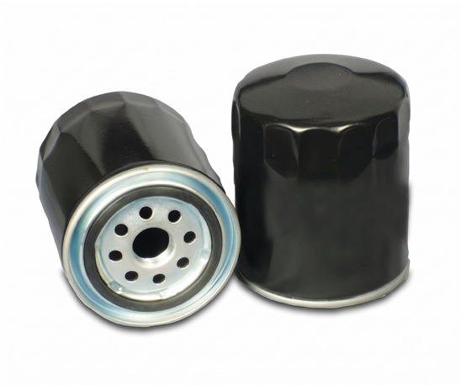
Products Suite
Bypass Filter & Valve Assemblies
Continuous Partial-Flow Colloidal Soot Removal
Bypass filters clean oil by diverting approximately 10% of total pump volume through high-density sub-micron depth media. This secondary polishing loop traps microscopic carbon particles down to 1 micron before returning purified oil directly to the engine sump.
Additionally, our stainless steel bypass valve manifolds (compatible with Fleck 2510, 5600, 9000 control heads with 3/4" NPT threading) provide smooth mechanical isolation for industrial fluid circuits.
1 Micron Particle Trap: High-density multilayer cellulose removes colloidal carbon, varnish, and combustion soot.
Fleck Valve Compatibility: Heavy duty stainless steel bypass manifold with 3/4" NPT connections for direct control mounting.
3x Extended Drain Intervals: Prevents viscosity shear and sludge build-up, significantly extending lubrication service life.
DHANJAL IMPEX (P) LTD. | IATF 16949 & ISO 9001 CERTIFIED OEM PARTNER

Slide 8
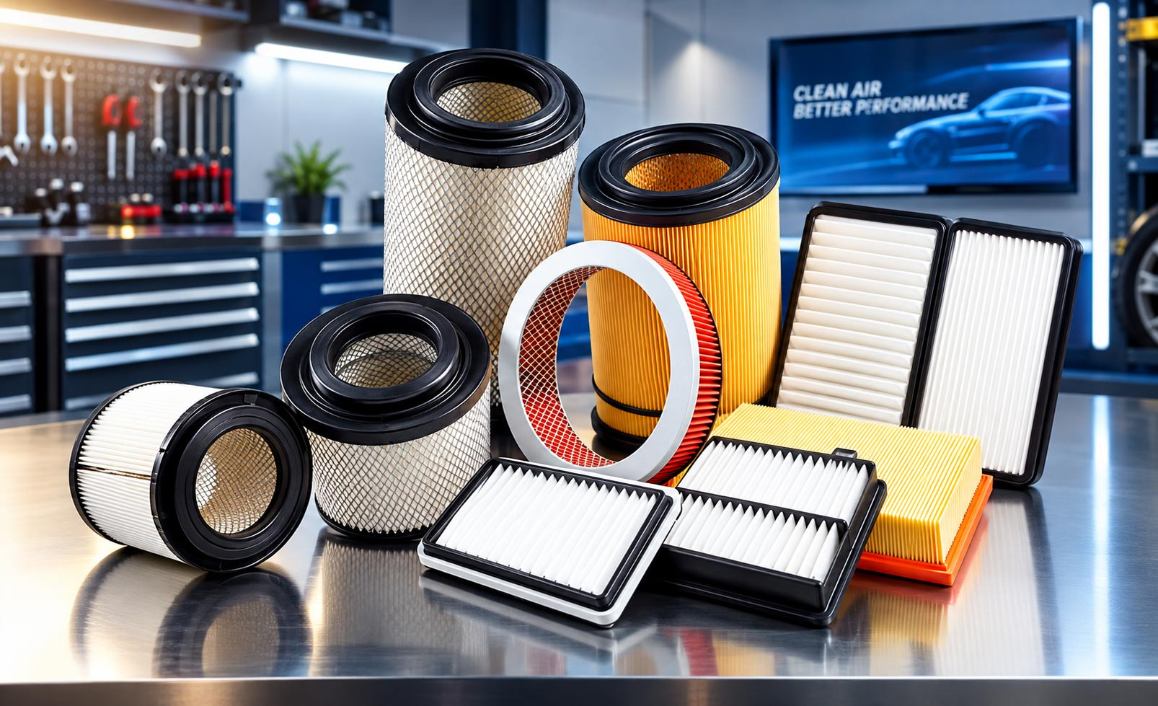
Products Suite
Automatic Air Filters
Superior Dust Retention with Minimal Restriction
We manufacture an advanced range of Air Filters for engine intake and cabin ventilation. Built to stringent OEM and international quality benchmarks, our engine air filters prevent abrasive road dust, silica, and soot from scouring cylinders and piston rings.
Additionally, our cabin filtration elements feature activated carbon media that adsorbs noxious exhaust fumes, pollen, and PM2.5 particulates, maintaining pristine cabin air quality.
Engine Wear Shield: Impregnated multi-density pleated media capturing 99.9% of harmful particulate matter above 10 microns.
Polyurethane Radial Seal: Soft polyurethane molded end caps providing a 100% airtight compression seal under vibration.
Cabin Activated Carbon: Electrostatic and activated carbon layers blocking allergens, odor, and fine airborne aerosols.
DHANJAL IMPEX (P) LTD. | IATF 16949 & ISO 9001 CERTIFIED OEM PARTNER

Slide 9




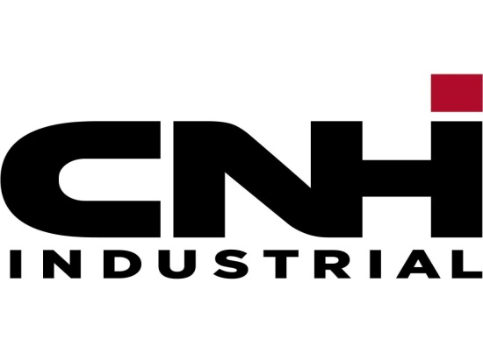



Our Clients
O.E.M Esteemed Customers
DHANJAL IMPEX (P) LTD. | IATF 16949 & ISO 9001 CERTIFIED OEM PARTNER
www.dhanjalimpex.com | info@dhanjalimpex.com

Slide 10
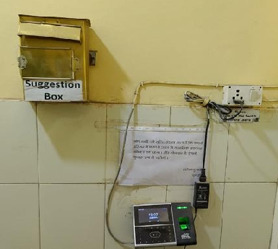
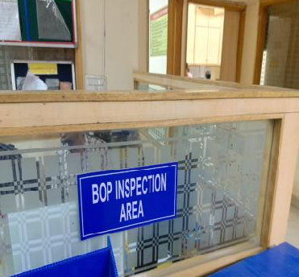
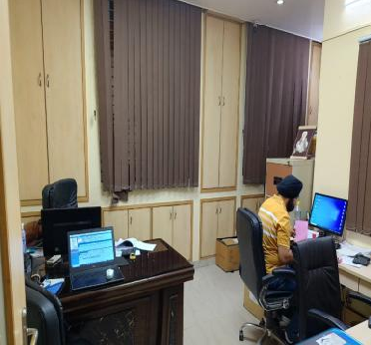
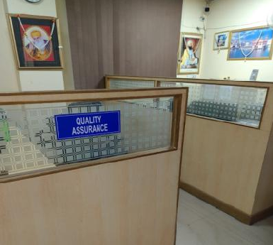
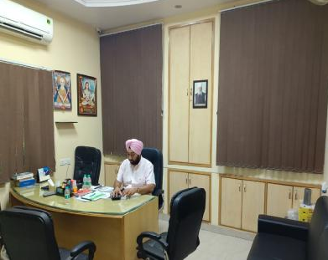
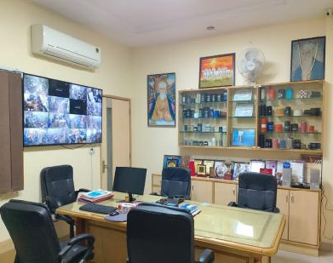
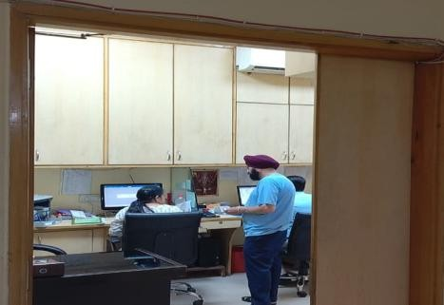
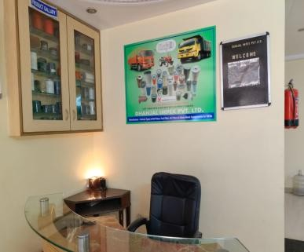
Manufacturing Plant
Our Office Overview
DHANJAL IMPEX (P) LTD. | IATF 16949 & ISO 9001 CERTIFIED OEM PARTNER
www.dhanjalimpex.com | info@dhanjalimpex.com

Slide 11
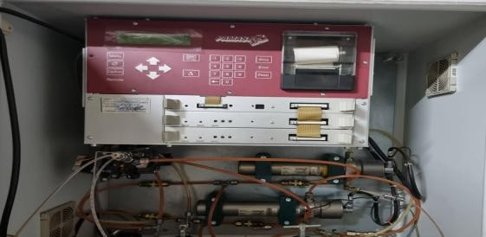
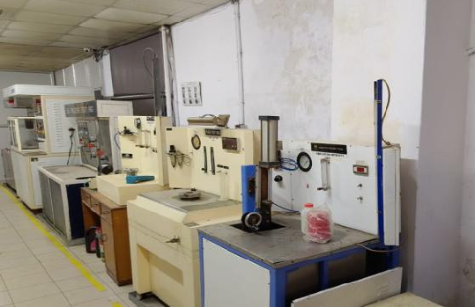
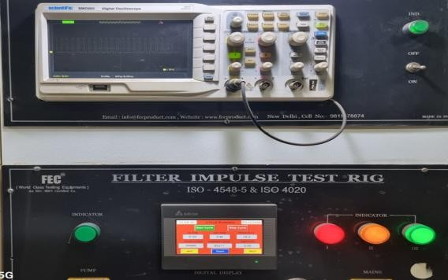
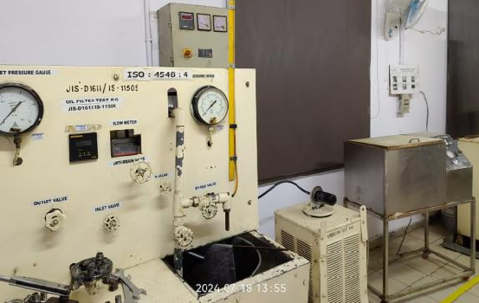
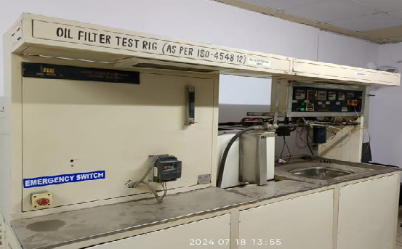
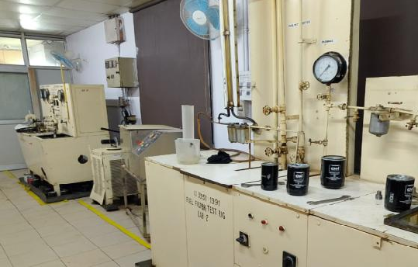
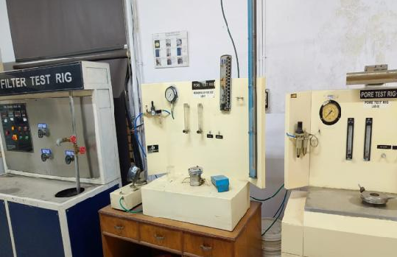
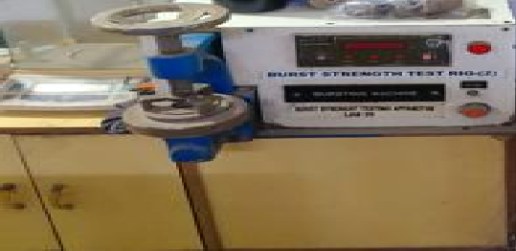
Manufacturing Plant
LAB Overview Filter Test Rigs & Test Facility
DHANJAL IMPEX (P) LTD. | IATF 16949 & ISO 9001 CERTIFIED OEM PARTNER
www.dhanjalimpex.com | info@dhanjalimpex.com

Slide 12
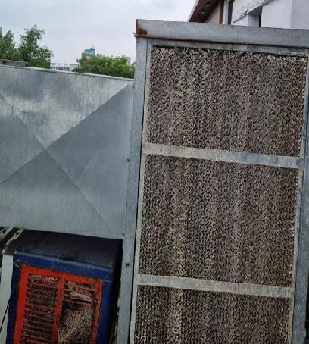
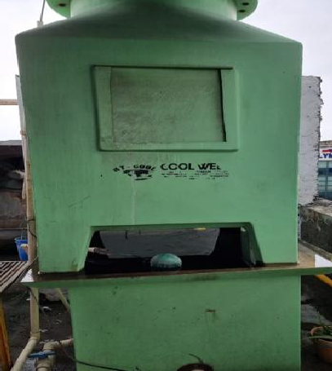
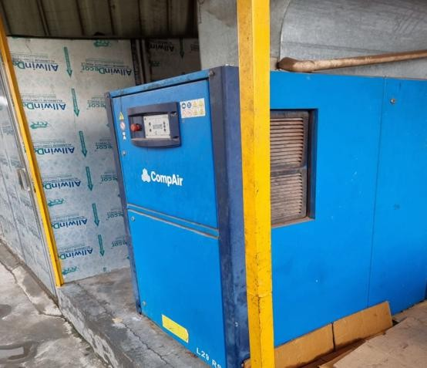
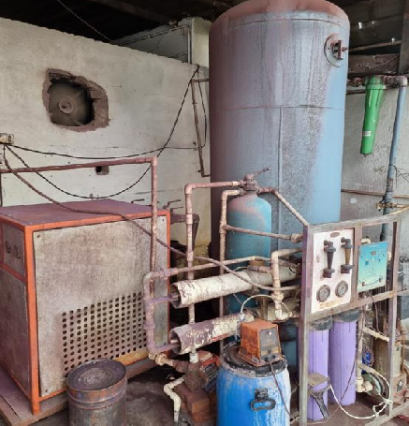
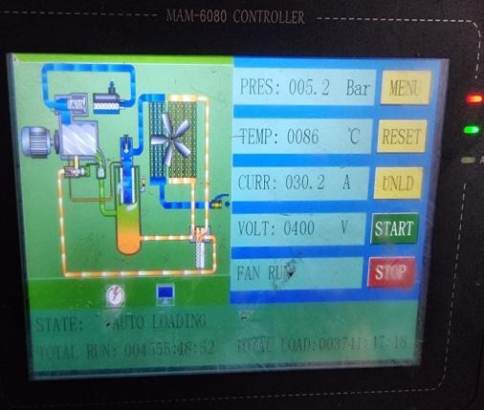
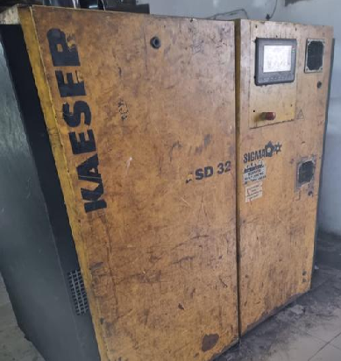
Manufacturing Plant
Plant Support Equipment Overview
2 Nos. Air compressors with electronic display
Cooling duct in all production areas
2 Nos. Dryer
Cooling plant
DHANJAL IMPEX (P) LTD. | IATF 16949 & ISO 9001 CERTIFIED OEM PARTNER
www.dhanjalimpex.com | info@dhanjalimpex.com

Slide 13
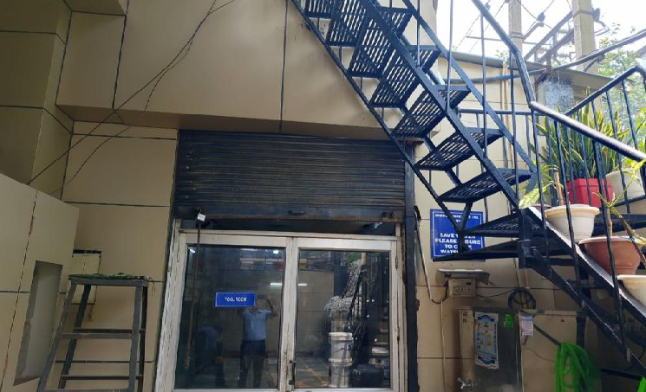
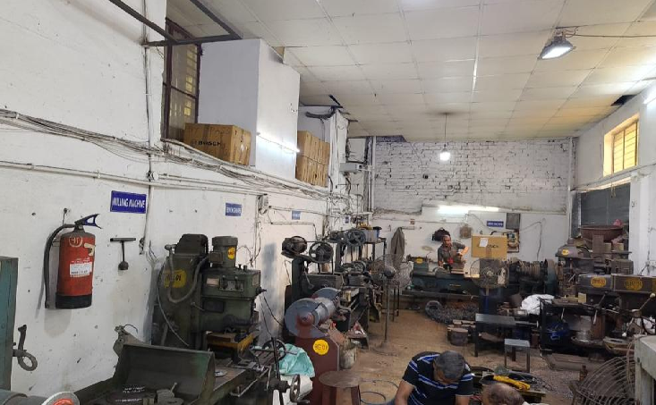
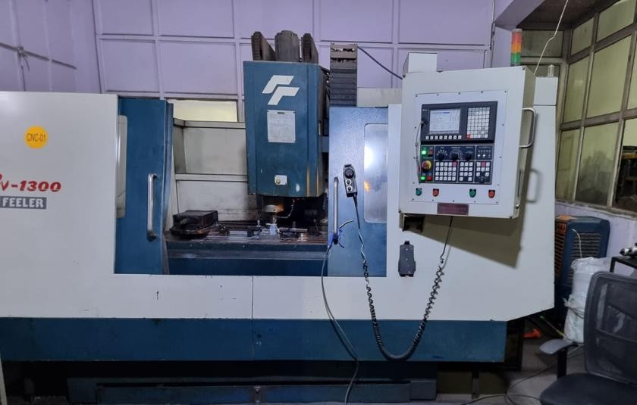
Manufacturing Plant
Tool Room Overview
4 Nos. Conventional Lathes
1 Nos. Surface Grinder
2 nos. Drilling Machine
1 Nos. VMC Machine for die making
DHANJAL IMPEX (P) LTD. | IATF 16949 & ISO 9001 CERTIFIED OEM PARTNER
www.dhanjalimpex.com | info@dhanjalimpex.com

Slide 14
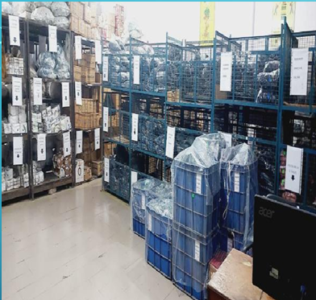
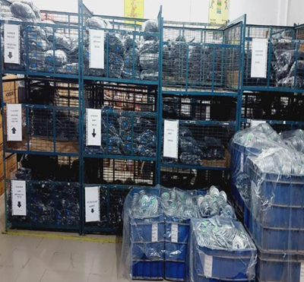
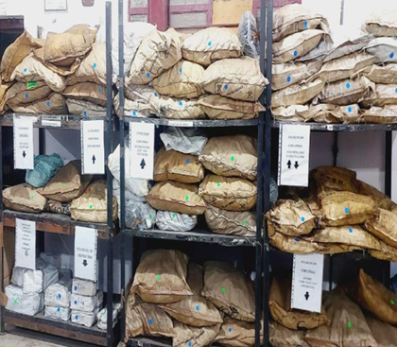
Manufacturing Plant
Storage Area Overview
4 Nos. Conventional Lathes
1 Nos. Surface Grinder
2 nos. Drilling Machine
1 Nos. VMC Machine for die making
DHANJAL IMPEX (P) LTD. | IATF 16949 & ISO 9001 CERTIFIED OEM PARTNER
www.dhanjalimpex.com | info@dhanjalimpex.com

Slide 15
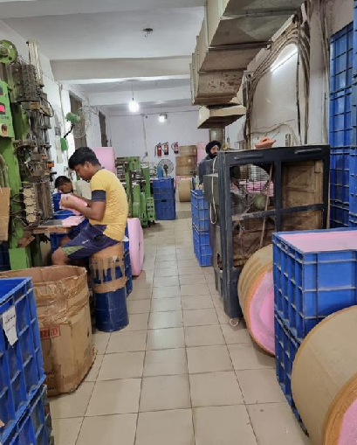
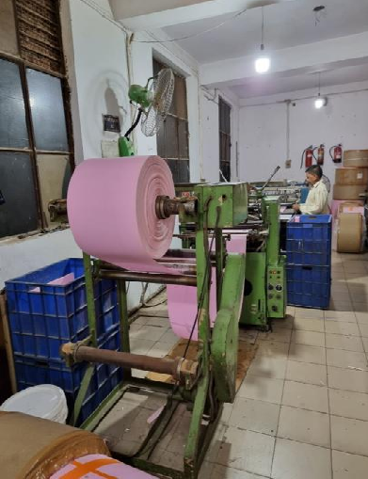
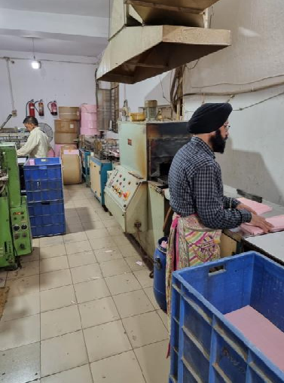
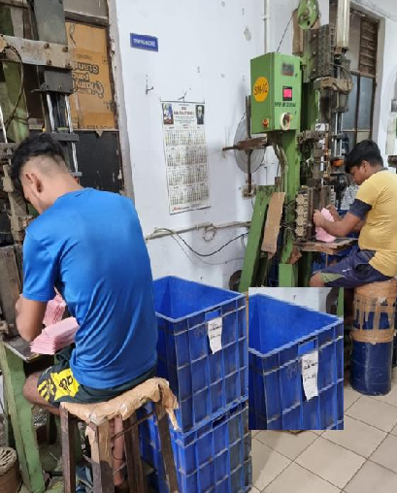
Manufacturing Plant
Element Pleating section Overview
2 Nos.Paper Pleating Machines
2 nos. conveyorized integrated media drying Oven
2 Nos.Paper Clipping Machines
DHANJAL IMPEX (P) LTD. | IATF 16949 & ISO 9001 CERTIFIED OEM PARTNER
www.dhanjalimpex.com | info@dhanjalimpex.com

Slide 16
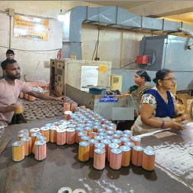
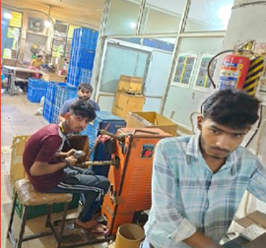
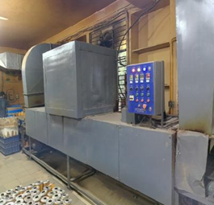
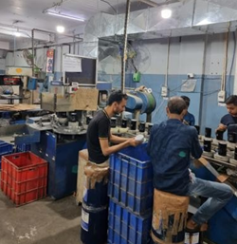
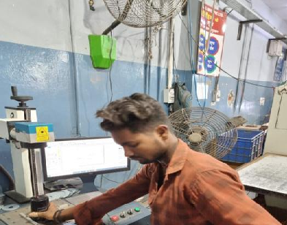
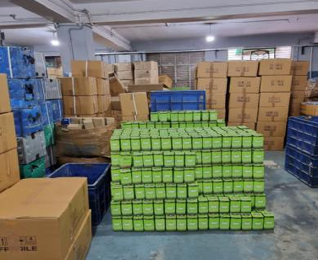
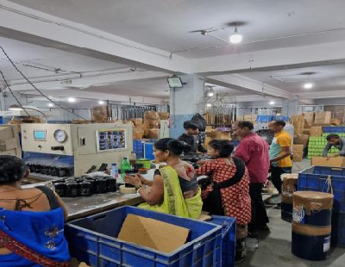
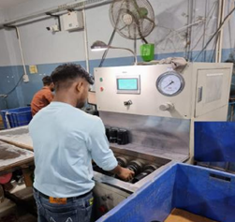
Manufacturing Plant
First Floor Overview
2 Nos. Filter Element line
Rolling & spot welding line
2 Nos. Element Curing Oven
2 Nos. Automatic & manual seaming Line
Laster printing M/C
FG Storage Area
Packing Line
Leak Testing M/C’s :-4 Nos.
DHANJAL IMPEX (P) LTD. | IATF 16949 & ISO 9001 CERTIFIED OEM PARTNER
www.dhanjalimpex.com | info@dhanjalimpex.com

Slide 17







Manufacturing Plant
Second Floor Overview
2 Nos. Automatic seaming machines
4 Nos. Manual seaming machines
2 Nos. Automatic leak testing machines
Packing Section Area
2 Nos. Additional mechanical leak testing Rigs
Test Lab Entry
FG Storage
DHANJAL IMPEX (P) LTD. | IATF 16949 & ISO 9001 CERTIFIED OEM PARTNER
www.dhanjalimpex.com | info@dhanjalimpex.com

Slide 18





Manufacturing Plant
Overview of dedicated Paint Shop at supplier end
2 Nos. Manual paint booths.
1 Nos. Automatic paint booth.
2 nos. Conveyor zed semi automatic drying Oven.
All painted material contains in blue PP boxes.
DHANJAL IMPEX (P) LTD. | IATF 16949 & ISO 9001 CERTIFIED OEM PARTNER
www.dhanjalimpex.com | info@dhanjalimpex.com

Slide 19
Manufacturing Plant
Coil Filter Section
2 Nos. Coil rolling & creep paper printing
Coil Filter Assly Line
Element store in blue 1000 GSM PP Box
DHANJAL IMPEX (P) LTD. | IATF 16949 & ISO 9001 CERTIFIED OEM PARTNER
www.dhanjalimpex.com | info@dhanjalimpex.com

Slide 20








Manufacturing Plant
Press Shop Section
No.of Press M/C:- 14 Nos. (B) No.of Projection Welding M/C:- 3 Nos
(C) No.of automatic tapping M/C:- 2 Nos. (D) Coil storage Area.
DHANJAL IMPEX (P) LTD. | IATF 16949 & ISO 9001 CERTIFIED OEM PARTNER
www.dhanjalimpex.com | info@dhanjalimpex.com

Slide 21

Manufacturing Plant
CAV Glue dispensing Machine
CAV Filter Glue Process Machine
DHANJAL IMPEX (P) LTD. | IATF 16949 & ISO 9001 CERTIFIED OEM PARTNER
www.dhanjalimpex.com | info@dhanjalimpex.com

Slide 22








Manufacturing Plant
Plant Air Ducting & Safety Measures Overview
Ducting for Cooling in all plant floor shops.
Fire extinguisher equipments implemented in all safety concern areas.
DHANJAL IMPEX (P) LTD. | IATF 16949 & ISO 9001 CERTIFIED OEM PARTNER
www.dhanjalimpex.com | info@dhanjalimpex.com

Slide 23




QUALITY ACCREDITATIONS
International Certifications & Accreditations
IATF 16949:2016
ISO 9001:2015
ISO 14001:2015
ISO 45001:2018
Automotive Quality Management
Quality Management System
Environmental Management
Occupational Health & Safety
APQP, FMEA, PPAP Level 3, and zero-defect compliance for global automotive OEM supply.
Systematic process management ensuring consistent manufacturing repeatability and traceability.
Sustainable green manufacturing, eco-friendly solvent recycling, and energy-efficient presses.
Safe workplace environment, ergonomic robotic handling, and hazard-free shopfloor protocols.
DHANJAL IMPEX (P) LTD. | IATF 16949 & ISO 9001 CERTIFIED OEM PARTNER
www.dhanjalimpex.com | info@dhanjalimpex.com

Slide 24
QUALITY ASSURANCE
Advanced QA Testing Lab & In-House Rig Capabilities
Hydrostatic Burst Rig
Multi-Pass Efficiency
Bubble Point Tester
Up to 35+ Bar
ISO 16889 / 4548-12
Pore Size Integrity
Verifies shell integrity, double-lock seam tolerance, and gasket retention under extreme spikes.
Online particle counting evaluating Beta ratios, fractional efficiency, and total Dirt Holding Capacity.
Determines first bubble point to guarantee absolute filtration integrity with zero pinhole defects.
Flow Fatigue & Impulse
Salt Spray Corrosion
Thermal & Cold Shock
100,000+ Cycles
500+ Hrs ASTM B117
-40 deg C to +150 deg C
Continuous pressure pulsation test simulating extreme heavy-duty engine cyclic conditions.
Accelerated environmental chamber testing to certify extreme outdoor weather & agrochemical durability.
Verifying elastomeric valve flexibility, adhesive curing, and seal resilience in extreme temperatures.
DHANJAL IMPEX (P) LTD. | IATF 16949 & ISO 9001 CERTIFIED OEM PARTNER
www.dhanjalimpex.com | info@dhanjalimpex.com

Slide 25




ACCOLADES
Awards, Trophies & Industry Recognitions
DHANJAL IMPEX (P) LTD. | IATF 16949 & ISO 9001 CERTIFIED OEM PARTNER
www.dhanjalimpex.com | info@dhanjalimpex.com

Slide 26




ACCOLADES
Awards, Trophies & Industry Recognitions
DHANJAL IMPEX (P) LTD. | IATF 16949 & ISO 9001 CERTIFIED OEM PARTNER
www.dhanjalimpex.com | info@dhanjalimpex.com

Slide 27




ACCOLADES
Awards, Trophies & Industry Recognitions
DHANJAL IMPEX (P) LTD. | IATF 16949 & ISO 9001 CERTIFIED OEM PARTNER
www.dhanjalimpex.com | info@dhanjalimpex.com

Slide 28
VALUE PROPOSITION
Why Partner with Dhanjal Impex?
01
100% In-House Tooling & CAD
02
Zero-Defect Quality Assurance
Die & mould design, 3D modeling, fluid flow simulation, and rapid sample turn-around in 2 weeks.
Burst pressure testing, bubble point integrity, and multi-pass efficiency checks on every batch.
03
10M+ Annual Units Capacity
04
Comprehensive 1,500+ SKUs
High-tonnage hydraulic deep-draw presses and automated seaming lines for Tier-1 volume needs.
Single-source partner for complete tractor, commercial vehicle, and genset filtration suites.
05
Direct Factory Cost Advantage
06
Dedicated OEM Engineering Desk
Integrated backward manufacturing ensures optimum cost efficiency and raw material quality.
Direct SLA-backed technical assistance, PPAP Level 3 documentation, and vendor inventory support.
DHANJAL IMPEX (P) LTD. | IATF 16949 & ISO 9001 CERTIFIED OEM PARTNER
www.dhanjalimpex.com | info@dhanjalimpex.com

Slide 29

B-251, Naraina Industrial Area Phase-I
New Delhi - 110028, India
Office Telephone: +91-11-45092575
Mobile: +91-9891207474
Official Email: info@dhanjalimpex.com
Official Website: www.dhanjalimpex.com
DHANJAL IMPEX PRIVATE LIMITED
Let's Build High-Performance Filtration Solutions Together

